Slide 1
Chapter 3: Using Variables and Constants

Slide 2
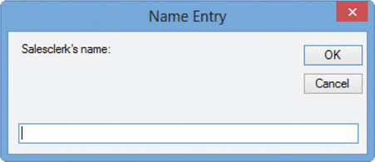
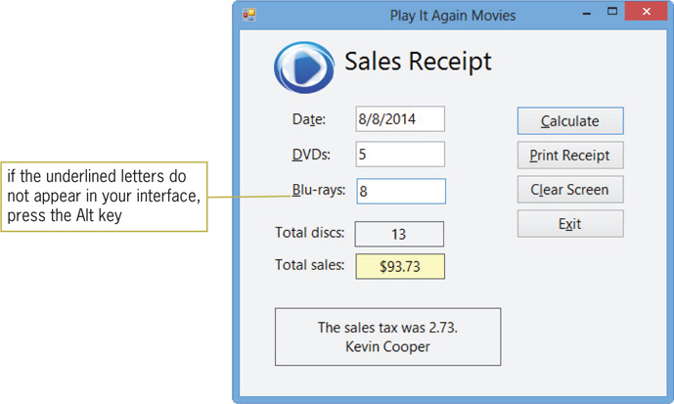
Previewing the Modified Play It Again Movies Application
Play It Again Movies application
New screen for salesclerk’s name
Sales tax added to order
Figure 3-1 Name Entry dialog box
Figure 3-2 Completed sales receipt

Slide 3
Lesson A Objectives
After studying Lesson A, you should be able to:
Declare variables and named constants
Assign data to an existing variable
Convert string data to a numeric data type using the TryParse method
Convert numeric data to a different data type using the Convert class methods
Explain the scope and lifetime of variables and named constants
Explain the purpose of Option Explicit, Option Infer, and Option Strict

Slide 4
Using Variables to Store Information
Controls and variables temporarily store data
Variable
A temporary storage location in main memory
Specified by data type, name, scope, and lifetime
Reasons to use variables
To hold information that is not stored in a control on the form
To allow for more precise treatment of numeric data
To enable code to run more efficiently

Slide 5
Using Variables to Store Information (cont.)
Selecting a Data Type for a Variable
Data type
Specifies the type of data a variable can store
Provides a class template for creating variables
Unicode
A universal coding scheme for characters
Assigns a unique numeric value to each character in the written languages of the world

Slide 6
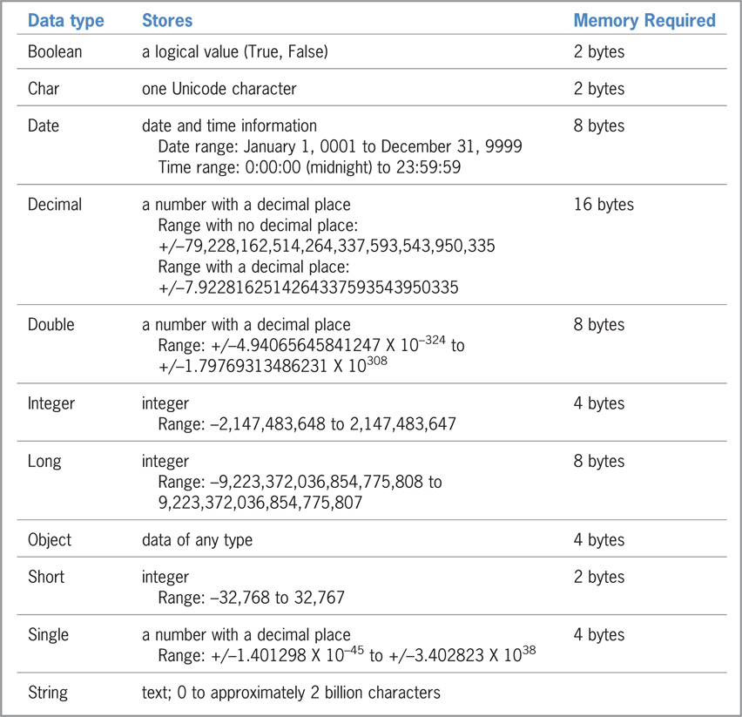
Using Variables to Store Information (cont.)
Figure 3-3 Basic data types in Visual Basic

Slide 7
Using Variables to Store Information (cont.)
The textbook uses:
The Integer data type for all integers
Either the Decimal or Double data type for numbers containing decimal places or numbers used in calculations
The String data type for text or numbers not used in calculations
The Boolean data type for Boolean values

Slide 8
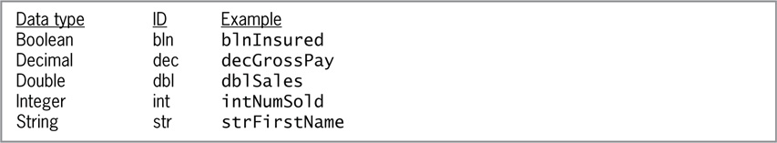
Using Variables to Store Information (cont.)
Selecting a Name for a Variable
Names must begin with a letter or underscore
Names can contain only letters, numbers, or underscores
No punctuation, special characters, or spaces are allowed
The recommended length for a name variable is 32 characters
Variable names cannot be reserved words (such as Sub or Double)
Figure 3-4 Three-character IDs and examples

Slide 9
Using Variables to Store Information (cont.)
Valid names:
intFeb_Income
decSales2014
dblEastRegion
strName
Invalid Names:
4thQuarter
The name must begin with a letter or underscore
dblWest Region
The name cannot contain a space
strFirst.Name
The name cannot contain punctuation
decSales$East
The name cannot contain a special character

Slide 10
Using Variables to Store Information (cont.)
Declaring a Variable
Declaration statement
Used to declare (create) a variable and reserve space in memory for it
If no initial value is given to a variable when declaring it, the computer stores a default value
Numeric variables are set to 0
Boolean variables are set to False
Object and String variables are set to Nothing
Date variables are set to 1/1/0001 12:00:00AM

Slide 11
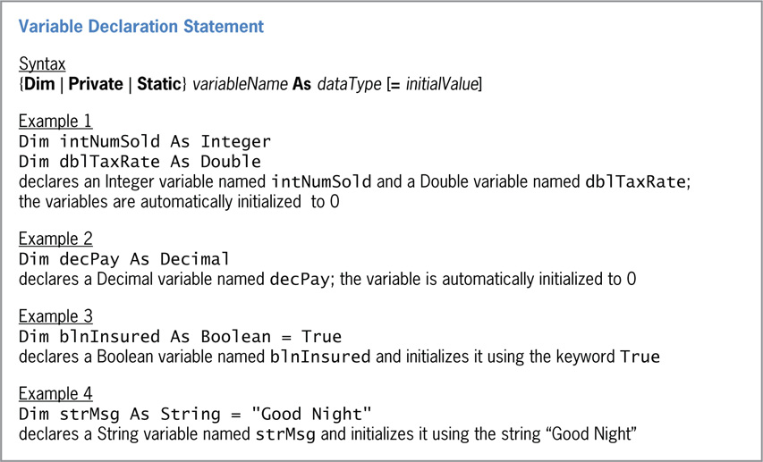
Using Variables to Store Information (cont.)
Figure 3-6 Syntax and examples of a variable declaration statement

Slide 12
Assigning Data to an Existing Variable
Assignment statement
Assigns a value to a variable at run time
Syntax: variablename = expression
An expression may include literal constants, object properties, variables, keywords, and arithmetic operators
Literal constant
A data item whose value does not change while the application is running
Example: The string “Mary”
Literal type character
Forces a literal constant to change its data type

Slide 13
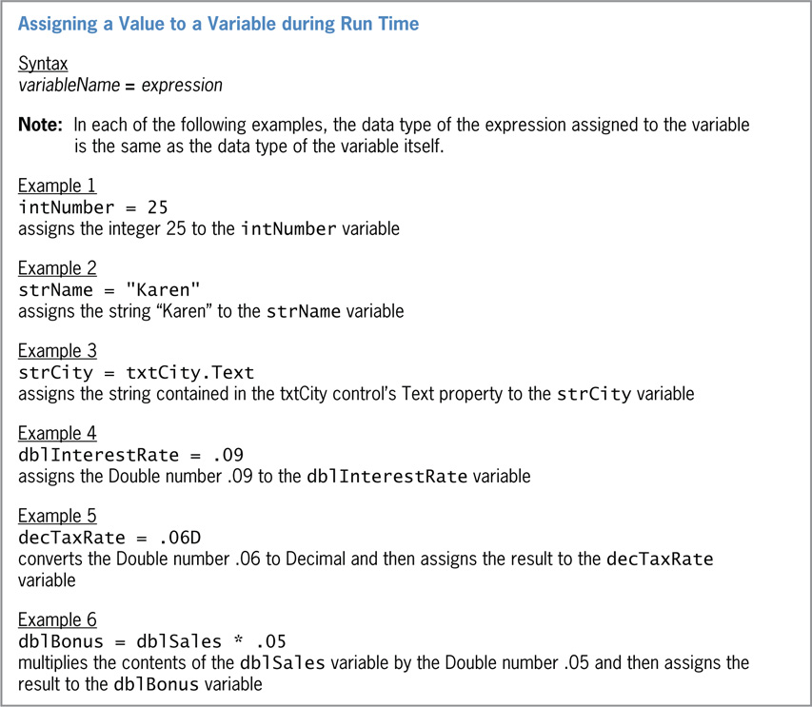
Assigning Data to an Existing Variable (cont.)
Figure 3-7 Syntax and examples of assigning a value to a variable during run time

Slide 14
Assigning Data to an Existing Variable (cont.)
The TryParse Method
Converts a string to a number
Is preferred over Val
Allows the programmer to specify the data type
Val only returns a Double number
Arguments
dataType: A numeric data type, such as Integer
String: A string to be converted
Variable: A variable that receives the numeric value

Slide 15
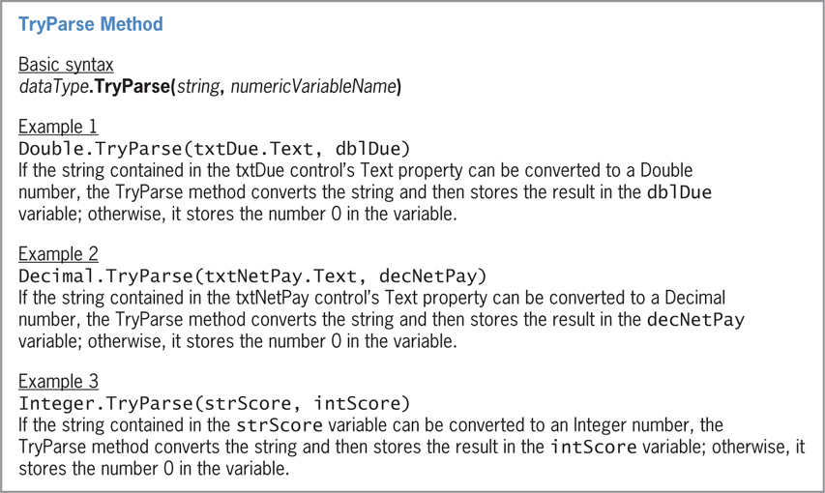
Assigning Data to an Existing Variable (cont.)
Figure 3-9 Basic syntax and examples of the TryParse method

Slide 16
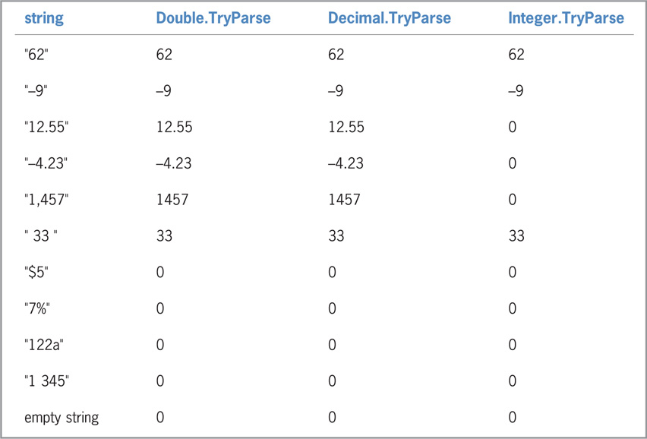
Assigning Data to an Existing Variable (cont.)
Figure 3-10 Results of the TryParse method for the Double, Decimal and Integer data types

Slide 17
Assigning Data to an Existing Variable (cont.)
The Convert Class
Can be used to convert a number from one type to another
Methods include ToDecimal, ToDouble, ToInt32, and ToString
TryParse is recommended for converting strings to numeric data types
Will not produce an error if the conversion fails

Slide 18
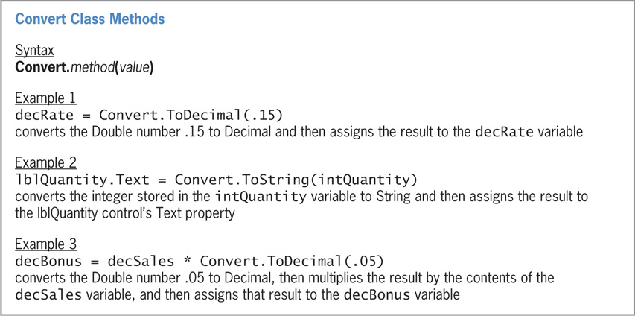
Assigning Data to an Existing Variable (cont.)
Figure 3-11 Syntax and examples of the Convert class methods

Slide 19
Complete You Do It 1 on Page 124

Slide 20
The Scope and Lifetime of a Variable
Scope
Indicates where a variable can be used
Lifetime
How long a variable remains in memory
Scope and lifetime are determined by where a variable is declared: either the General Declarations section or the form’s Declaration section
Three types of scope:
Class: The variable can be used by all procedures in a form
Procedure: The variable can be used within a procedure
Block: The variable can be used within a specific code block

Slide 21
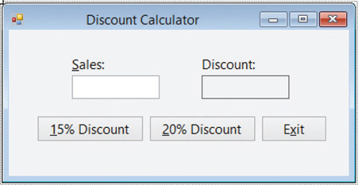
The Scope and Lifetime of a Variable (cont.)
Variables with Procedure Scope
Can be used only by that procedure
Declared at the beginning of the procedure
Removed from memory when the procedure ends
Declared using the Dim keyword
Most variables used in this course will be procedure-level variables
Figure 3-12 User Interface for the Discount Calculator application

Slide 22
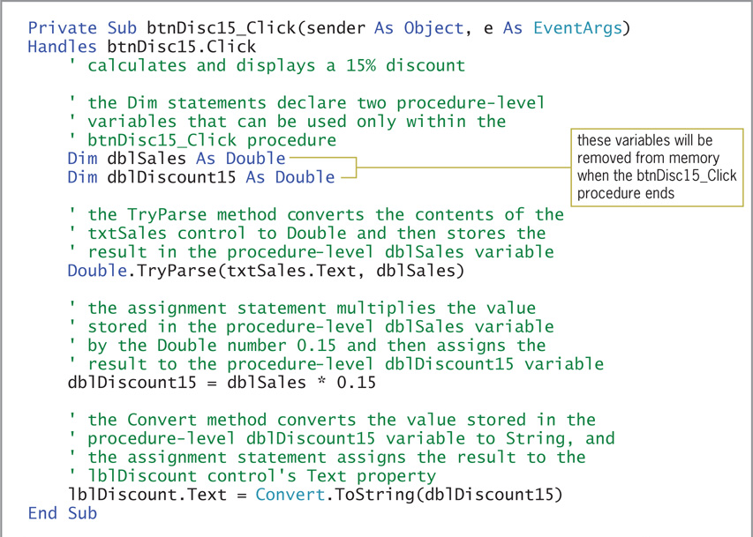
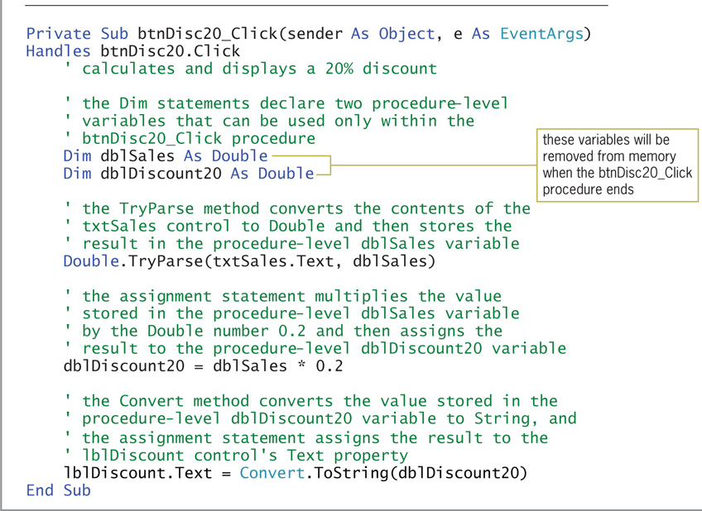
The Scope and Lifetime of a Variable (cont.)
Figure 3-13 Click event procedures using procedure-level variables

Slide 23
Create Interface on page 125
Code Page 126

Slide 24
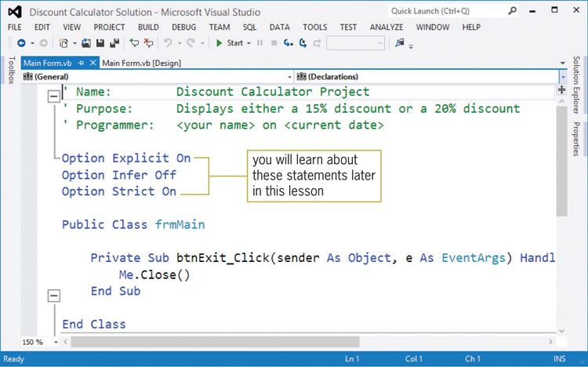
The Scope and Lifetime of a Variable (cont.)
Figure 3-14 Code Editor window for the Discount Calculator application

Slide 25
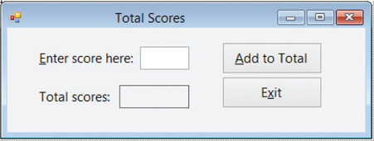
The Scope and Lifetime of a Variable (cont.)
Variables with Class Scope
Can be used by all procedures in the form
Declared in the form’s Declarations section
Will remain in memory until the application ends
Declared using the Private keyword
Figure 3-16 User Interface for the Total Scores application

Slide 26
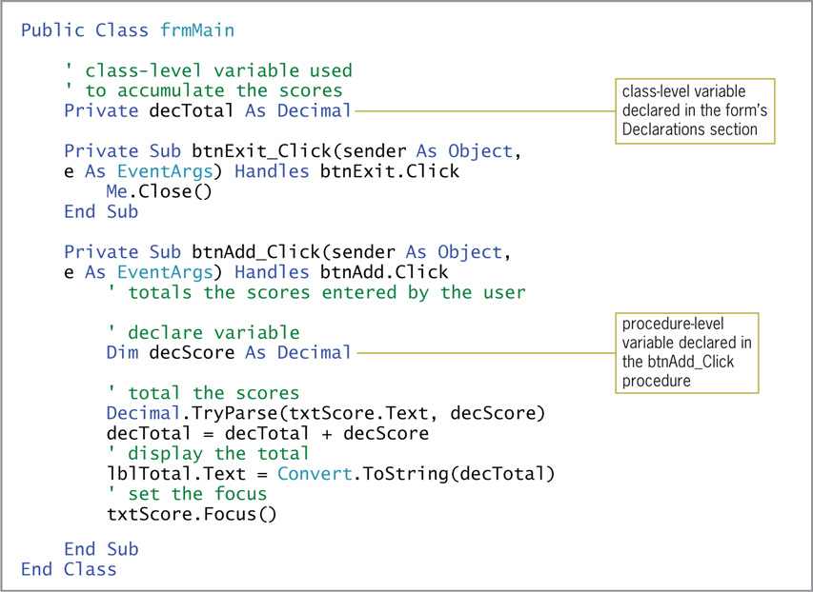
The Scope and Lifetime of a Variable (cont.)
Figure 3-17 Total Scores application code using a class-level variable

Slide 27
Create Interface on page 128
Enter code on page 129

Slide 28
Static Variables
Static variable
A procedure-level variable with an extended lifetime
Remains in memory between procedure calls
Retains its value even when the procedure ends
Static keyword
Used to declare a static variable
Static variables act like class-level variables but have narrower scope
They can only be used by the procedure in which they are declared

Slide 29
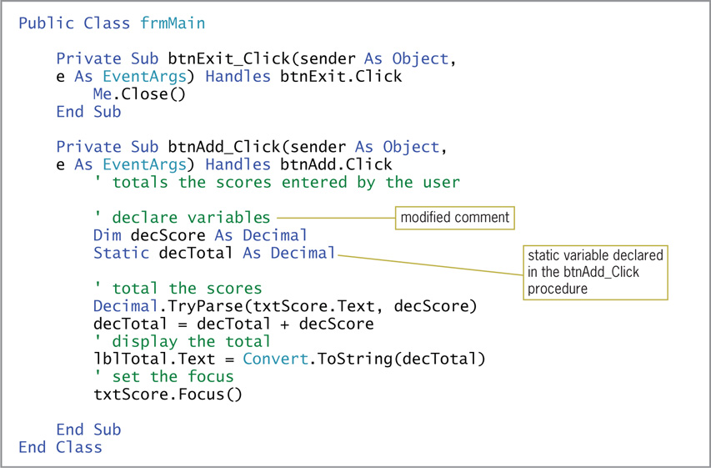
Static Variables (cont.)
Figure 3-19 Total Scores application’s code using a static variable

Slide 30
Change previous code to include a Static Variable

Slide 31
Complete You Do it 2 on page 132

Slide 32
Named Constants
Named constant
A memory location inside the computer whose contents cannot be changed at run time
Const statement
Creates named constant
Stores value of expression in a named constant
expression: Can be a literal constant, another named constant, or an arithmetic operator
Cannot contain a variable or method

Slide 33
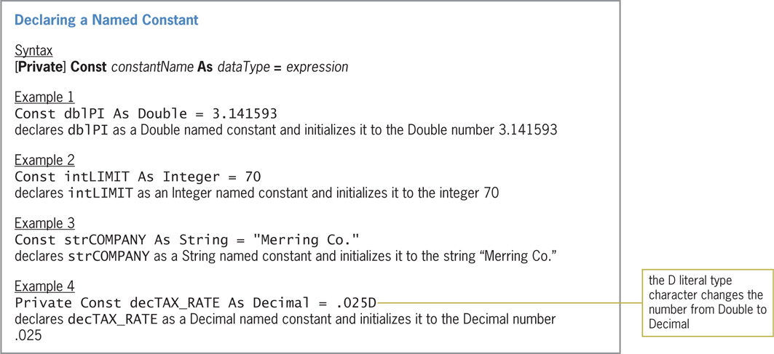
Named Constants (cont.)
Figure 3-20 Syntax and examples of the Const statement

Slide 34
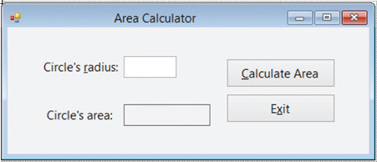
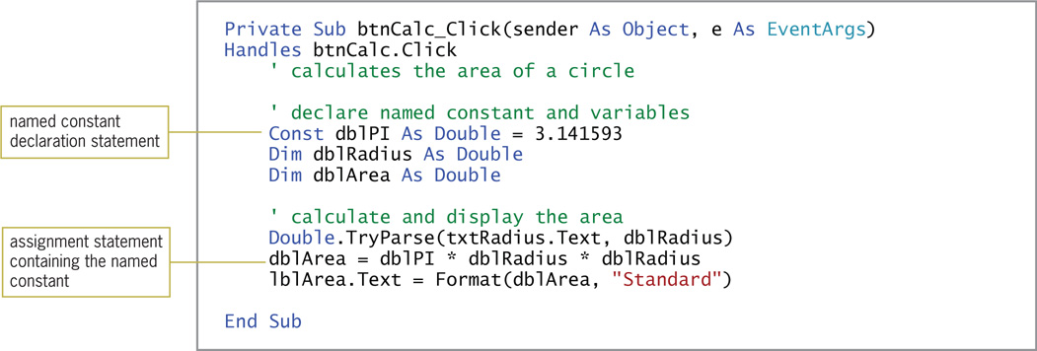
Named Constants (cont.)
Figure 3-21 User interface for the Area Calculator application
Figure 3-22 Calculate Area button’s Click event procedure

Slide 35
Create interface on page 134
Code on page 134

Slide 36
Option Statements
Option Explicit and Option Infer
Prevent you from using undeclared variables
Option Strict
Implicit type conversion
Converts the right-side value to the data type on the left side
Promotion
Data is converted to a greater precision number (e.g., Integer to Decimal)
Demotion
Data is truncated (e.g., Decimal to Integer)
Data loss can occur when demotion occurs
Infer
Ensures that every variable is declared with a data type

Slide 37
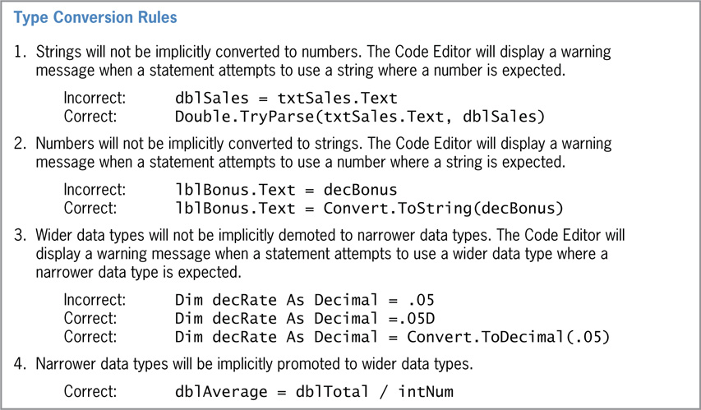
Option Statements (cont.)
Option Strict (cont.)
Disallows implicit conversions
Type conversion rules are applied when this option is on
Figure 3-24 Rules and examples of type conversions

Slide 38
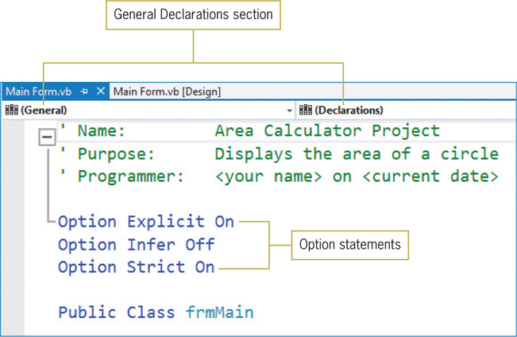
Option Statements (cont.)
Figure 3-25 Option statements entered in the General Declarations section

Slide 39
Lesson A Summary
Declare a variable using {Dim | Private | Static}
An assignment statement assigns a value to a variable
Three levels of scope: block, procedure, class
The TryParse method converts strings to numeric data
Use Const to declare a named constant
Avoid programming errors by using Option Explicit On, Option Infer Off, and Option Strict On

